Slide 1
Basildon and Brentwood Alliance
Virtual Views
Notes:
Engagement HQ, Granicus

Slide 2
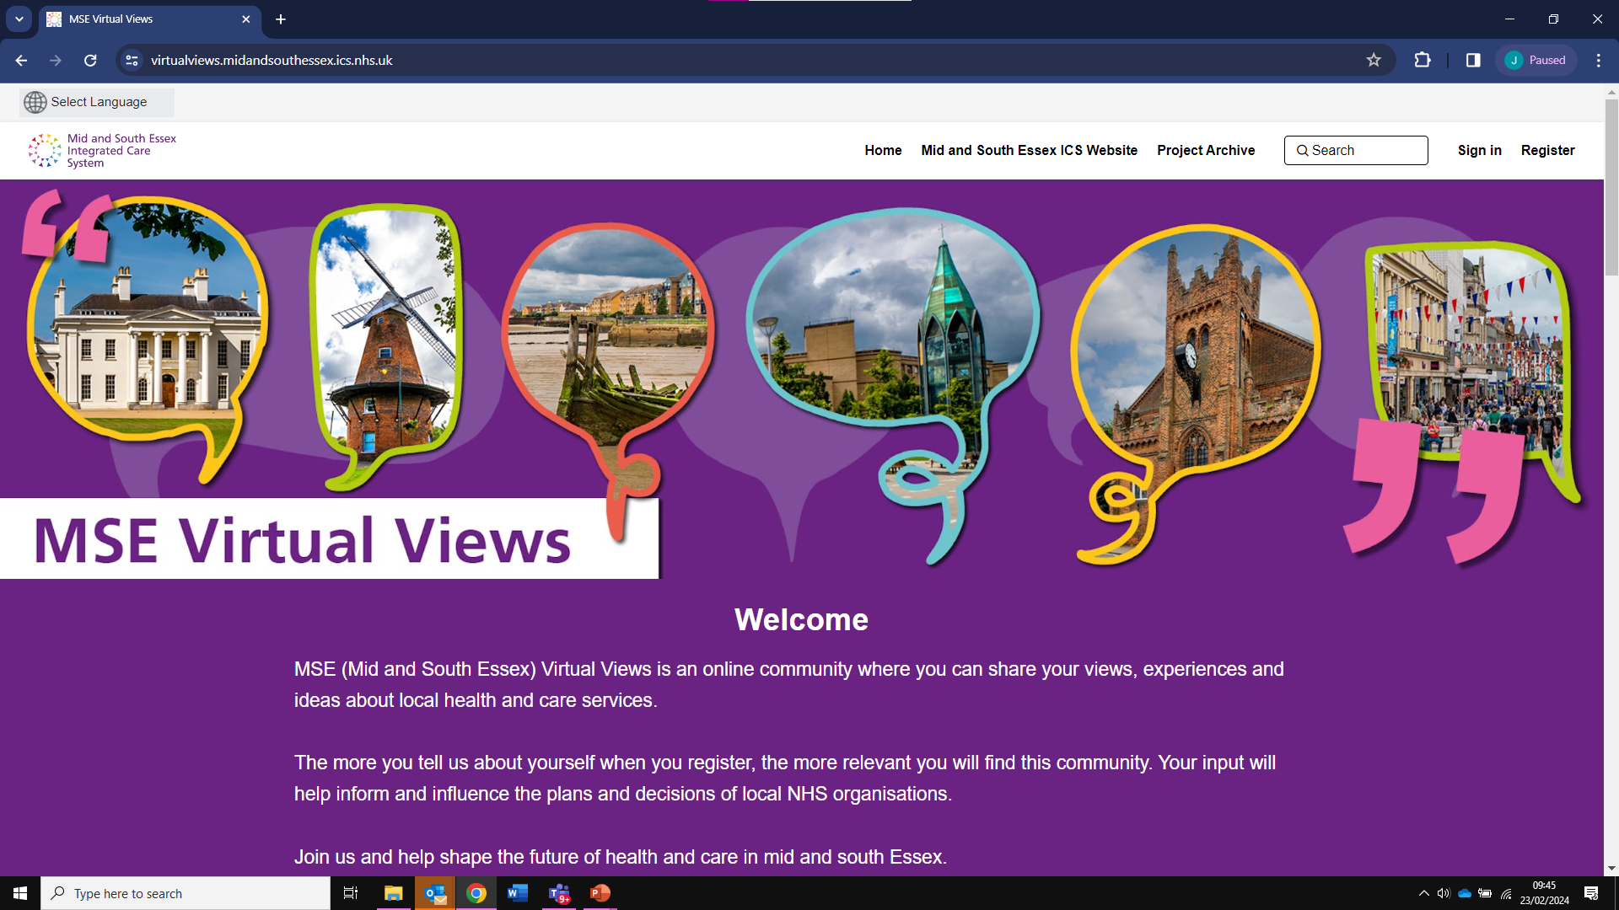
MSE Virtual Views
Visit: www.virtualviews.midandsouthessex.ics.nhs.uk/
www.midandsouthessex.ics.nhs.uk

Slide 3
Our Alliance Engagement Hubs

Slide 4
This is a really key point
Current Projects
Draft Projects
Basildon and Brentwood Active Alliance
Basildon and Brentwood Active Practice
Active Alliance fund and resources
Talk to us Basildon and Brentwood
Central Basildon PCN Pilot
Basildon and Brentwood Slipper Swaps
Professionals only page
Basildon & Brentwood Social Prescribers Network

Slide 5
What is on Offer?
Statutory Consultation
Community Engagement
Capacity building
One-off surveys ( GDPR compliant )
Strategic Pages
Professionals' pages
Newsletters
Forums, questions, stories to build community
Notes:
1 For Statuary commissioning ( we don’t currently do this in our team)
2 Engaging with public to create a new service design or see feedback on the service is at ( Pilot pcn) or planning a change in a current service ( survey consultation )
3 Get people aware or involved using health campaign / slipper swaps / patients panels example young people/ special communities/
4 Resources and information pages such as the Well be domain or start well or Active alliance fund and resources ( also hosting management of the fund application process )
5 One off targeted but can be public if needed ( such as post event )
6 To develop and Strategy they might have a strategic consultation within but a wider offer such as public engagement events, organizations involved, ideas, forums, and panels. This relates to number 2 wider offer
7 Such as social prescribers network ( integrated care and offer) various roles, working in the community front facing to aces information without laptop over the phone !
8 To target a specific group that might not want to be accessible to the wider community by example staff surveys /
9 to target all subscribed in the Hub or to an specific page/project

Slide 6
BB Active Practice Network
1
2
3
4
BB Active Alliance
Active Alliance fund and resources
Talk to us BB
Supporting surgeries to become and Active Practice to get patients and staff more Active.
Funding resources and link to become accredited.
Supporting staff to get more active across the alliance with free and accessible activities and resources to support further development.
Funding that is available for health leads, community groups, charities, faith groups, and Alliance partners to deliver projects to increase Activity.
Feedback experiences of health and care across Basildon and Brentwood.
Notes:
Link on the next page

Slide 7
Basildon and Brentwood Active Practice Network | MSE Virtual Views (ics.nhs.uk)
Basildon and Brentwood Active Alliance | MSE Virtual Views (ics.nhs.uk)
Active Alliance fund and resources | MSE Virtual Views (ics.nhs.uk)
Talk to us Basildon and Brentwood | MSE Virtual Views (ics.nhs.uk)

Slide 8
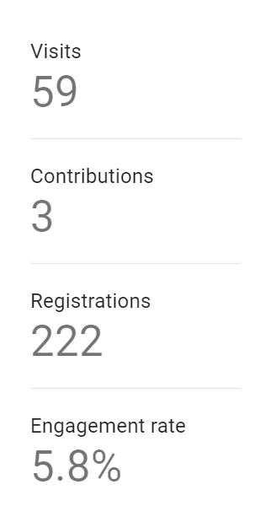
Launch on 28th September until January 28th

Slide 9
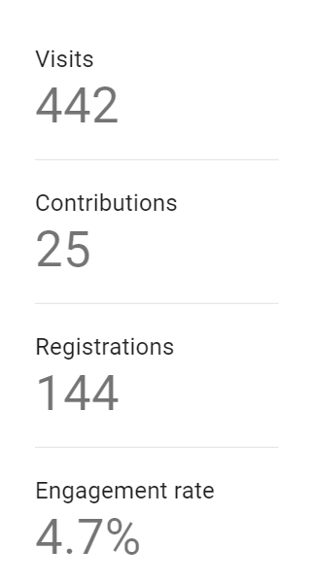
From the 28th of January to the 5th of June

Slide 10
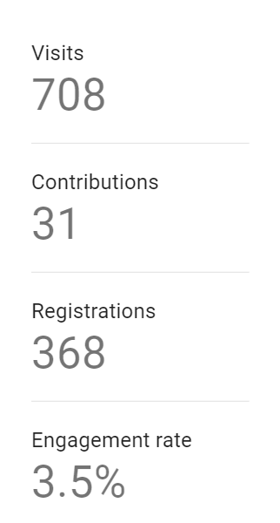
Current Data
708 - unique visitors
31 - people have contributed
368 - have registered
3.5 % - have engaged
Notes:
Launch in 28th September

Slide 11
BB Active Practice Network
1
2
3
4
BB Active Alliance
Active Alliance fund and resources
Talk to us BB
Data
200 Visitors
44 Max per day
149 Aware
43 Informed
Data
164 Visitors
Max per day 18
115 Aware
35 Informed
Data
98 visitors
10 Max per day
63 Aware
13 Informed
Data
69 Visitors
9 Max per day
57 Aware
18 Informed

Slide 12
Time to learn engagement feedback
150 attendees
38 GP staff/NHS signed up
20 people engaging in events
400 connections
Basildon and Brentwood Active Practice Network | MSE Virtual Views (ics.nhs.uk)
Engagement 186 Downloads 46
Basildon and Brentwood Active Alliance | MSE Virtual Views (ics.nhs.uk)
Engagement 74 Downloads 21
Active Alliance fund and resources | MSE Virtual Views (ics.nhs.uk)
Engagement 49 Downloads 9 (under one month for this one)
Notes:
This is important and there is not been much around communications from the initial email out just our team sharing the information, team meetings and in person events.
We had over 150 attendees to the event, We have as a result 38 GP staff/ NHS have signed up to follow up on joining our physical activities (Walks, rackets sports, heritage walks, etc) Tennis table competitions future events. We have around 20 people on the day engaging in various games at different times and spaces.
We also can report back that since the pages were launched, we have had over 400 engagements and connections via them, many had mentioned at the event they had seen the pages before but had not looked at them in detail as a result I can see we have had people after event downloading items, reading the news and accessing the information more widely please links and data to today.

Slide 13
Online Versus in Person engagement

Slide 14
Reaching diverse communities
It’s cost-effective
Increased engagement and reach of underrepresented groups
Informed decision-making
Strengthen community partnerships
Improves Transparency
Notes:
1 people at work/parents'/ content readily accessible via phone or tablet
2 less printing creating traffic and driving subscription to page or registration drives that information is been shared at the click of a button
3 ( accessible in many languages ) and their convenience ( shift workers evening work )
4 Digital tools simplify this time-consuming task; the data is easy to analyse and take action on. This allows your team to spend more time finalizing and getting reports approved.
5 Virtual public engagement can strengthen community partnerships by providing more opportunities for collaboration and communication
6 with traditional engagement methods, community members may not have access to all the information they need to make informed decisions. They may also ask themselves—how will my input make a difference? What will they do with our feedback? Close the look you said we did

Slide 15
Next steps
Pages strategy and communications plan
Variety of pages/projects
Closing the loop you said we did!
Feedback
Notes:
1 from a better understanding of what is on offer and what do we want to achieve from virtual views, who will lead this going forward and in the team who would support this work and is there capacity to do this or shall we continue as we are and a strong communication plan not to lose momentum and create click and interest from the community an partners
2 BB Alliance Landing page with the offer of what we do, who is involved in, featuring partners / Health inequalities projects, community pcns initiatives, neighborhood/anchor, and what has been achieved.
3 Transparency has been able to demonstrate that we have achieved what we set out to do

Slide 16
Thank you for your time Questions
maria.medina5@nhs.net
www.midandsouthessex.ics.nhs.uk

