Slide 1
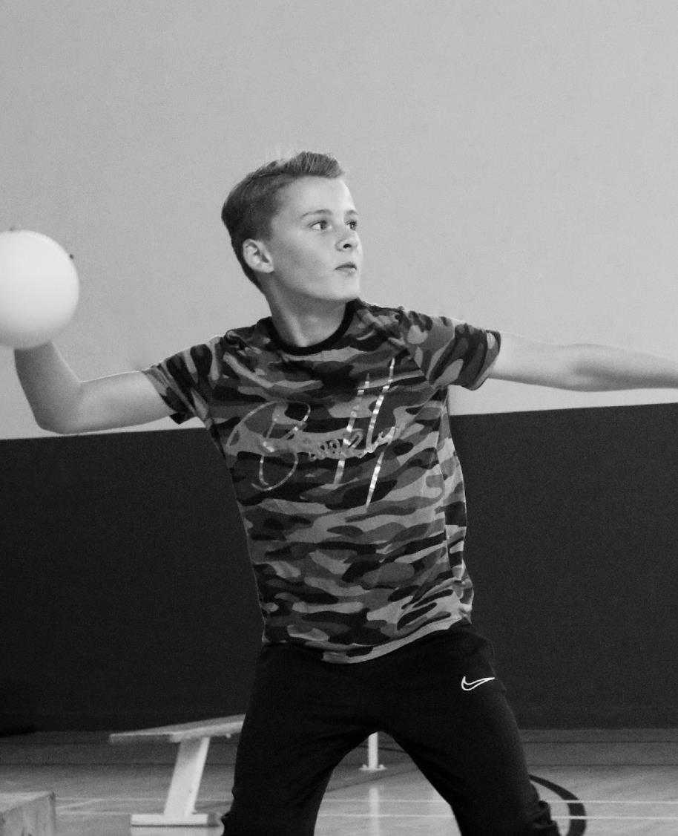
Towards Physical Literacy: A movement first approach to physical activity and physical education
Mark David Williams

Slide 2
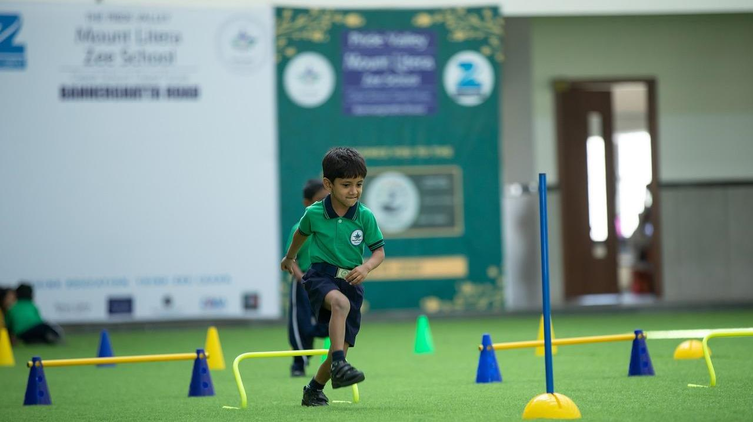
Glossary of Terms
Physical Activity (PA)
WHO defines physical activity as any bodily movement produced by skeletal muscles that requires energy expenditure.
Physical Education (PE)
Planned progressive learning within school curriculum centred around learning to move and moving to learn (afPE)
Organised (traditional) Competitive Sports (CS)
Structured learning beyond curriculum
Physical Literacy (PL)
Recently, Sport England have redefined PL as our relationship with movement and physical activity throughout life

Slide 3
Why Physical Literacy?
SPORT IS NOT FOR EVERYONE
MOVEMENT & PHYSICAL ACTIVITY IS FOR ALL
HEALTH AND PHYSICAL AND MENTAL WELLBEING

Slide 4
Physical Literacy: a multidimensional concept
Affective Motivation
Confidence
Physical competence
Cognitive
Knowledge
Understanding
Behavioural
Engagement in physical activity across the life span
(Cornish et al., 2020)

Slide 5
Philosophical Underpinnings of PL (IPLA)
Monism
Mind and body are an integrated entity
No existence of non-physical activity
Existentialism
As individuals, we are a direct result of the experiences we have had
Create meaningful experience
Phenomenology
The lived experience of the world and how it is perceived
Recognise uniqueness

Slide 6
Contextualising Physical Literacy
PE
PA
Where are your biases?
Equal weighting
CS
PL

Slide 7
How do we help children to fall in love with movement?
Primary socialisation
Early years development
Fun
Engaging
Broad content
Regular
Competence
Challenge
What if children at age 11 do not have a love of movement?

Slide 8
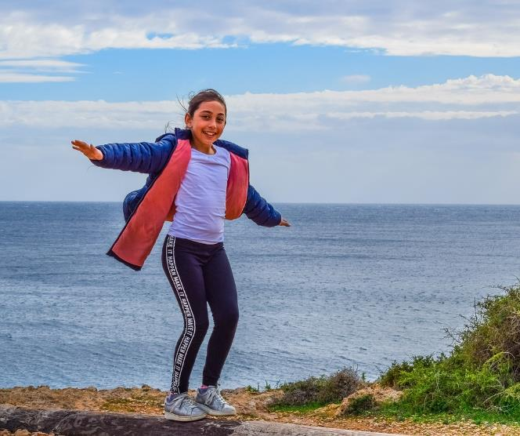
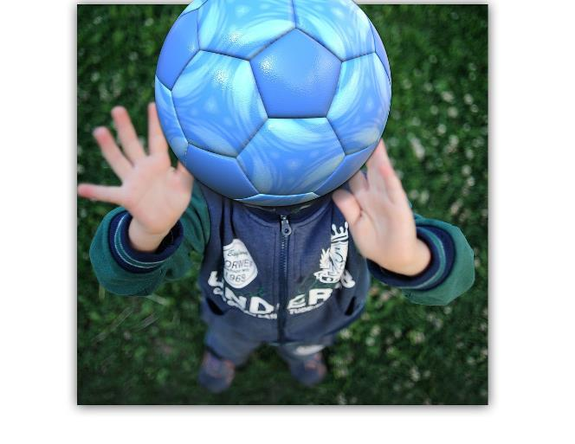
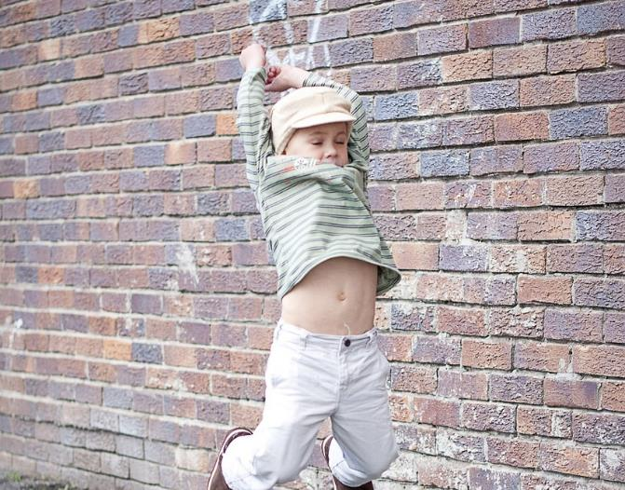
Fundamental Movement Skills (FMS)
Object manipulation
Locomotive
Balance
Considered foundations to sports specific skills (?)

Slide 9
(Hulteen et al., 2018)

Slide 10
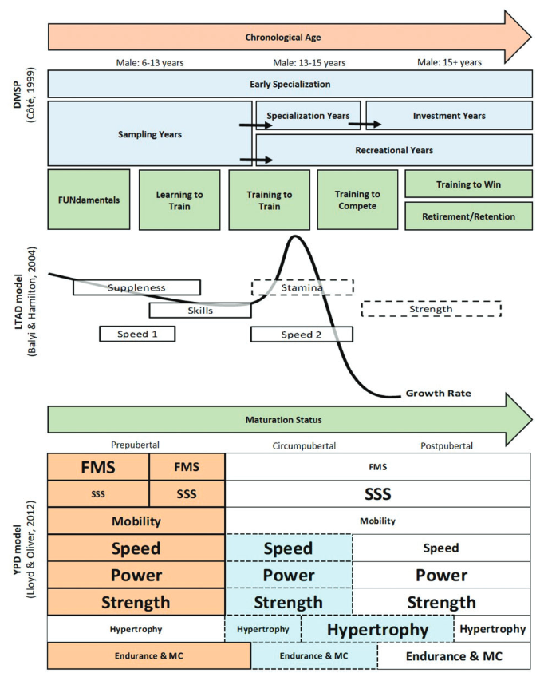
The place of youth athletic development within PL

Slide 11
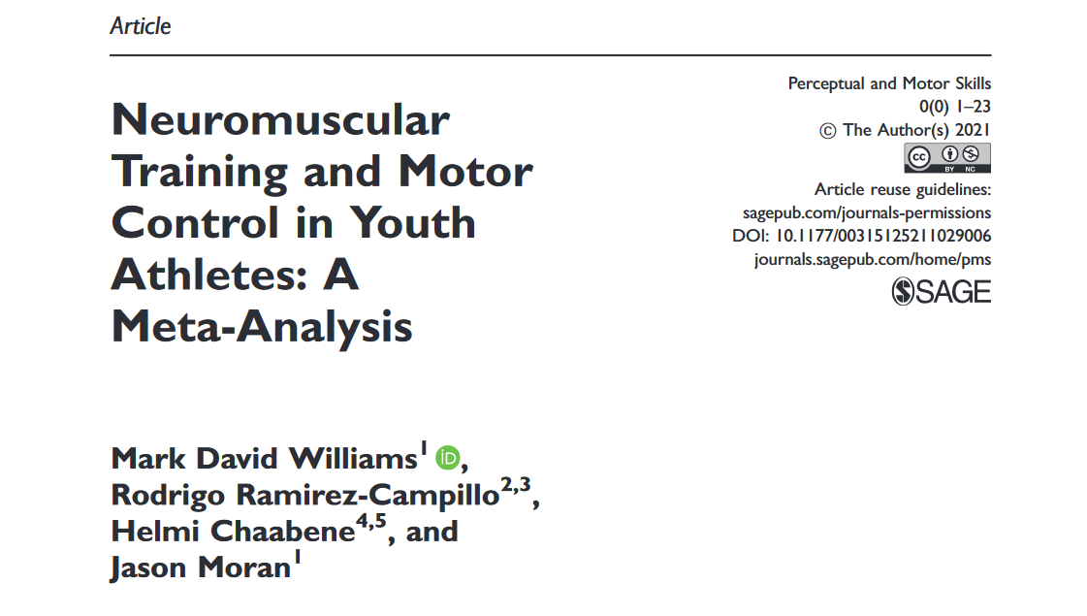
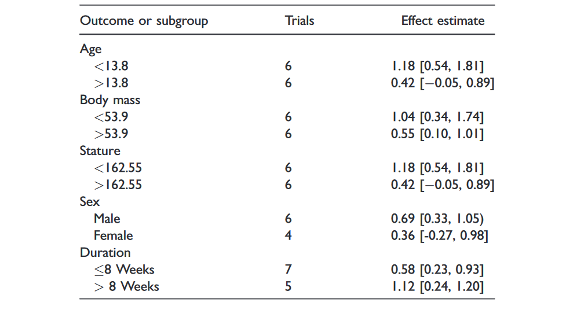
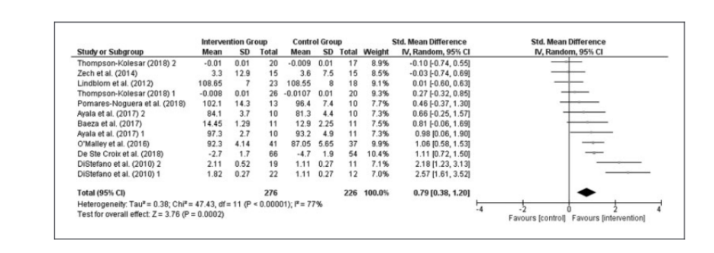
Pre-adolescence golden period in motor control

Slide 12
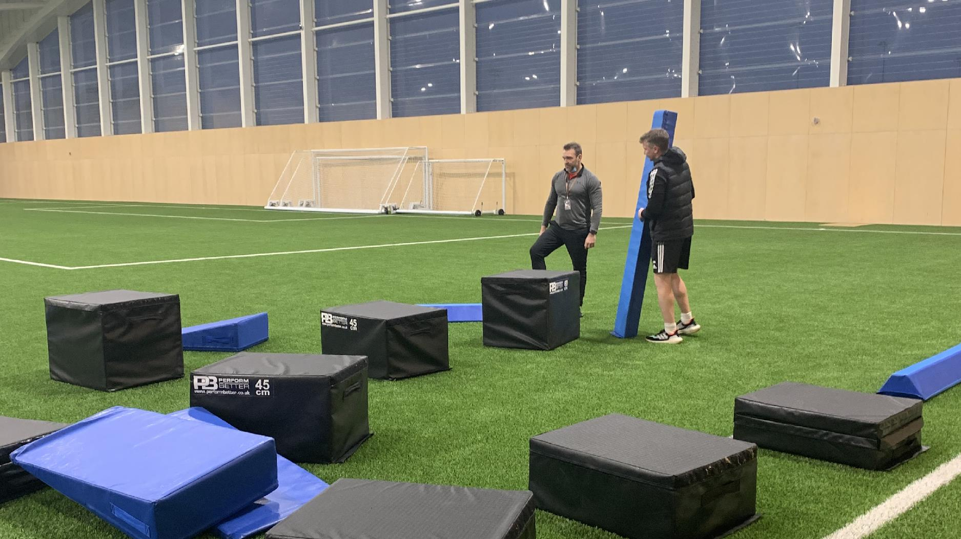
Non-conventional approaches

Slide 13
The Ecological Dynamics Approach to Motor Learning & PL
Task
Perception-action coupling
Self-organisation
Repetition without repetition
Constraints led approach (CLA)
Non-linear pedagogy
Environment
Individual

Slide 14
Beyond athletic development: the effects of parkour-based versus conventional neuromuscular exercises in pre-adolescent basketball players
 | Pre-knee flexion angle left (˚) | Post-knee flexion angle left (˚) | Pre-knee flexion angle right (˚) | Post-knee flexion angle right (˚) | Pre-10-m time(s) | Post-10-m time (s) | Pre-CMJ (cm) | Post-CMJ (cm) | Pre-peak relative power (W/kg) | Post-peak relative power (W/kg) | Pre-Landing net peak force (N/kg) | Post-Landing net peak force (N/kg) | Pre-speed-run time (s) | Post-speed run time (s)
Conventional Group | 115.72 ± 19.57 | 132.84 ± 20.94 | 119.84 ± 21.90 | 140.56 ± 22.92 | 2.11 ± 0.19 | 2.05 ± 0.14 | 21.54 ± 3.95 | 22.16 ± 3.68 | 38.84 ± 7.19 | 40.12 ± 7.23 | 36.57 ± 9.99 | 41.41 ± 8.93 | 8.89 ± 1.15 | 8.35 ± 0.86
Parkour Group | 118.14 ± 26.20 | 123.29 ± 19.60 | 117.88 ± 24.25 | 128.28 ± 22.66 | 2.06 ± 0.25 | 2.07 ± 0.19 | 17.93 ± 4.57 | 18.80 ± 4.79 | 33.50 ± 4.51 | 35.46 ± 4.50 | 38.74 ± 8.20 | 42.48 ± 18.45 | 9.37 ± 0.98 | 9.26 ± 1.00
Control Group | 134.89 ± 20.40 | 122.71 ± 33.11 | 135.39 ± 16.96 | 123.77 ± 30.46 | 2.01 ± 0.16 | 2.00 ± 0.22 | 21.28 ± 1.74 | 22.16 ± 5.36 | 37.64 ± 1.74 | 38.78 ± 6.14 | 32.91 ± 13.17 | 50.24 ± 18.71 | - | -
Note. Means and standard deviations (±) for each dependent measure.
No significant differences found between groups or by time

Slide 15
Design a movement-based / motor control warm-up

Slide 16
Navigating maturation?

Slide 17
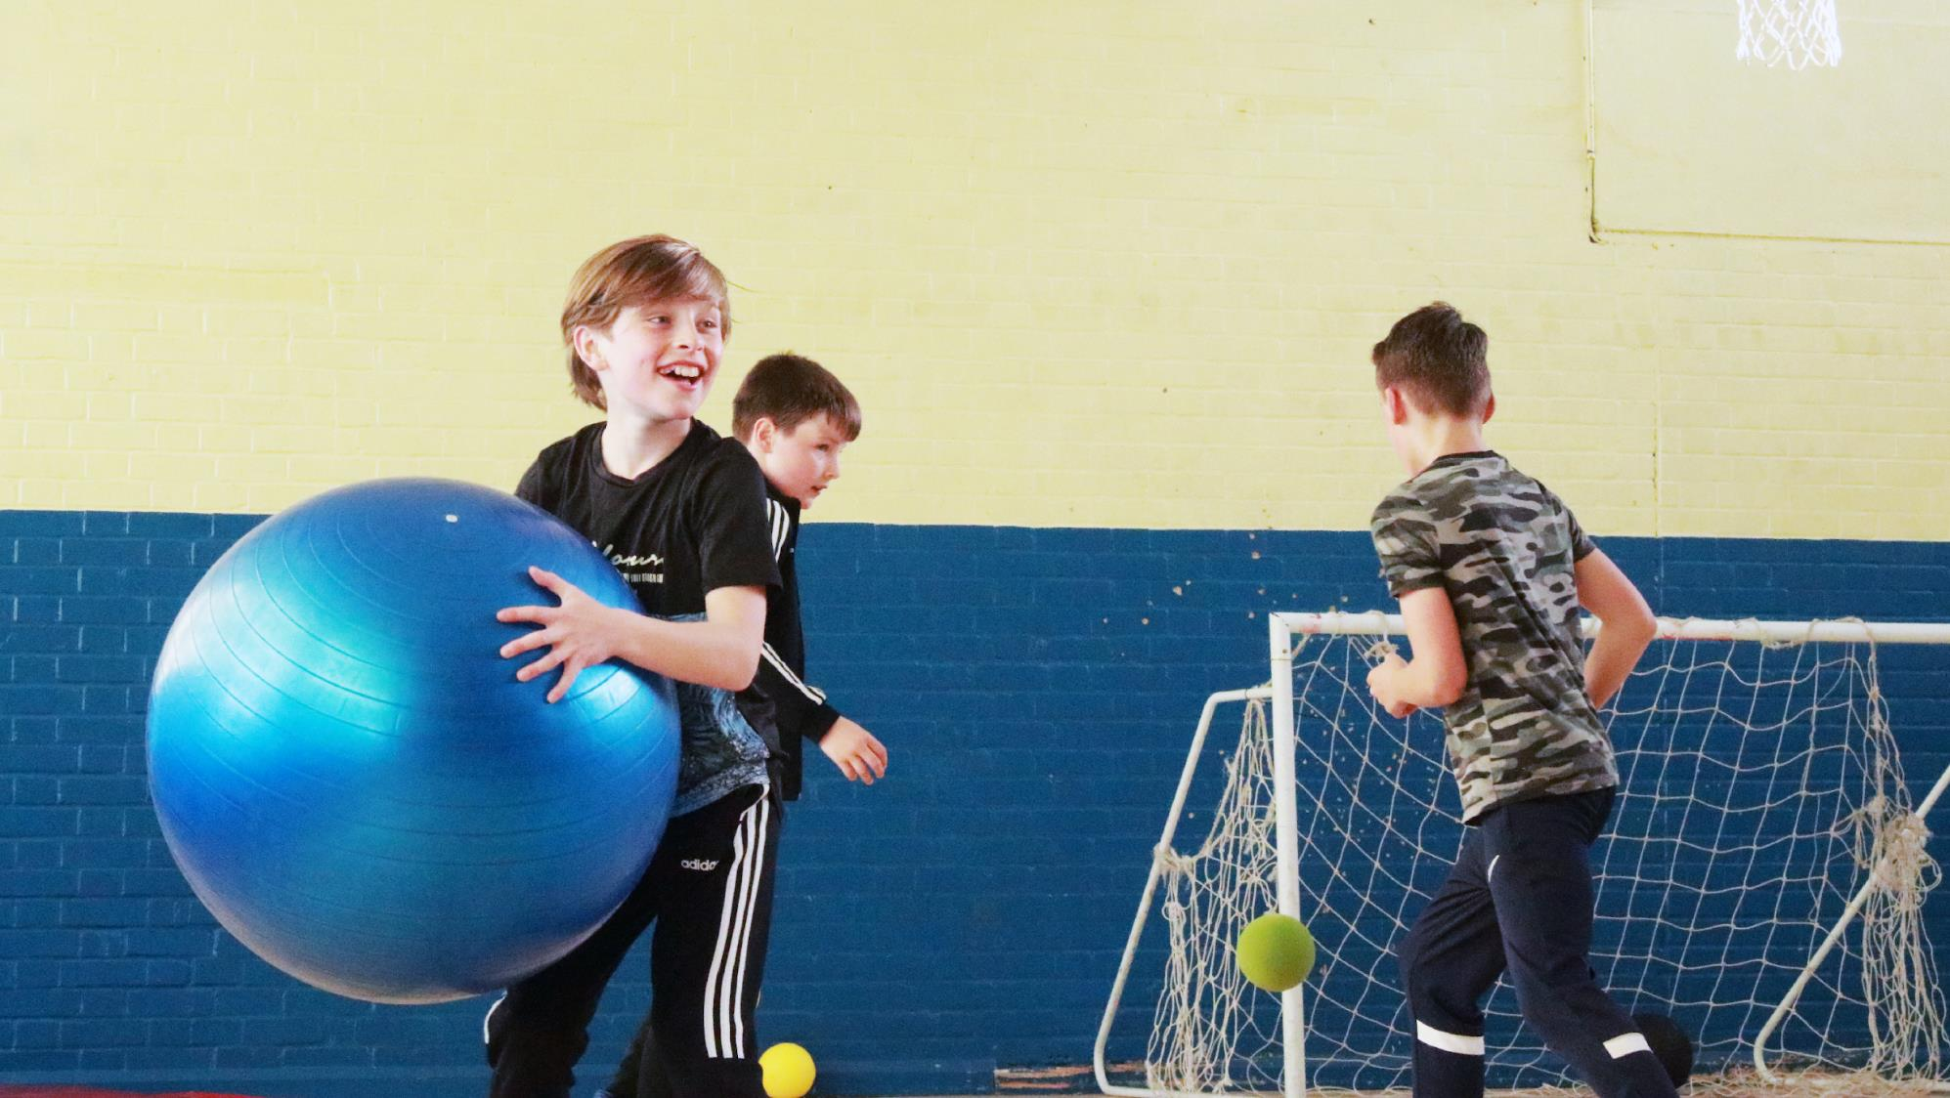
Thank you
Physical activity is movement
Physical education is movement
Physical literacy is movement

