Slide 1
‘Rethink Activity’ Project
Mel Islin
Physical Activity Programme Manager

Slide 2
Richmond Group of Charities
Movement for All Programme – collaborative approach to increasing physical activity in partnership with Sport England, Activity Alliance and Mind.
10 charities from the Richmond Group of Charities received funding from Sport England
Collectively, the Richmond Group of Charities reaches 15 million people living with a long term condition
www.rethink.org

Slide 3
Aim of the project
Seek to explore whether we can overcome the barriers which prevent people severely affected by mental illness and carers from engaging in physical activity by embedding activities into peer support groups
Aim to support inactive people to do at least 30mins per week
Contributes to NHS England’s drive to increase social prescribing opportunities
www.rethink.org

Slide 4
About the project
3 year project – 2018-2021
Support and enable community organisations to embed physical activity into their current offer
Create sustainable opportunities for people to be active
Member-led activity choices
Support drive to reduce mortality gap and improve physical health
www.rethink.org

Slide 5
Delivery
Engage with peer support groups, services and community organisations
Embed physical activity into groups using toolkit and provide all necessary support;
Funding
Training
Information and guidance (activities, instructors, venues, etc)
www.rethink.org

Slide 6
Toolkit
‘First stop shop’ for information for groups to start facilitating physical activity provision
Includes;
What is physical activity and benefits
Barriers and solutions
Top tips
Activity ideas
Case studies
Useful contacts
Co-produced with people with lived experience of mental illness
www.rethink.org

Slide 7
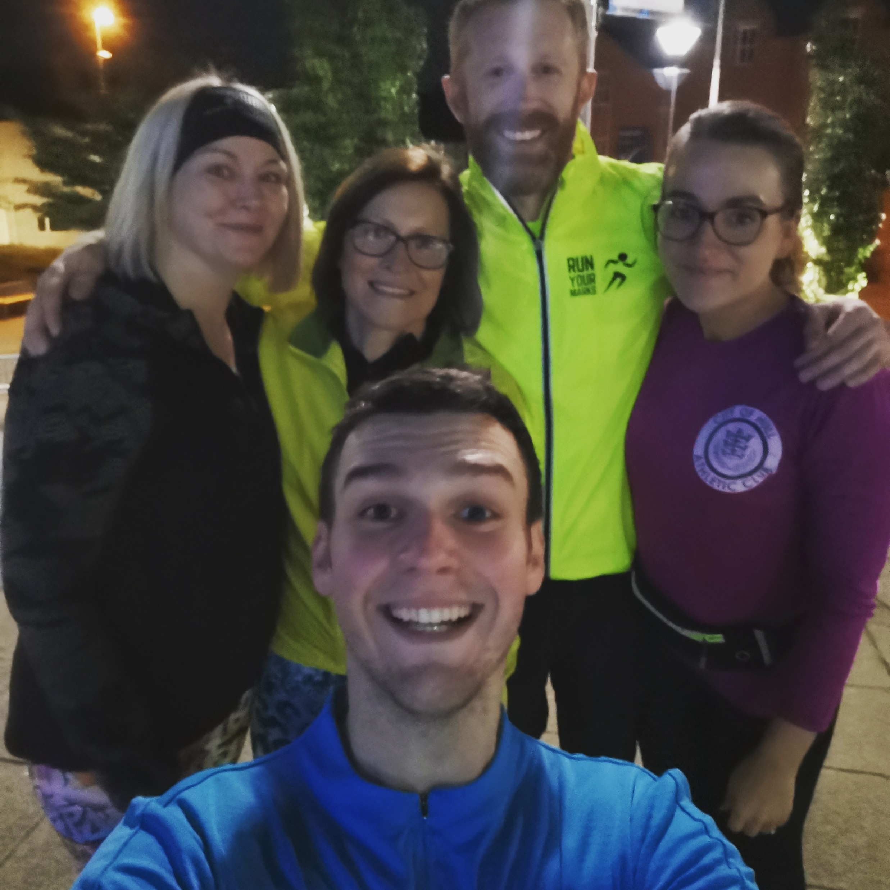
Activities (year 1 and 2)
Activity | Methodology | Activity | Methodology
4 x Walking | Information and guidance / walk leader training | 2 x Tai chi/Qigong | Information and guidance
3 x Table tennis | Equipment | 1 x Basketball | Venue hire
3 x Boxing (non-contact) | Equipment | 1 x Boccia | Equipment
3 x Gym | Equipment | 1 x Chair-based exercise | Instructor and training
3 x Yoga | Instructor and training | 1 x Cycling | Information and guidance
3 x Racket sports | Equipment / venue hire | 1 x Football | Venue hire
2 x Running/Jogging | Run leader training
www.rethink.org

Slide 8
Evaluation
Measure the impact on people affected by mental illness
Quantitative evaluation – questionnaires (baseline, 3, 6 and 12 months)
Qualitative evaluation – focus groups/1:1 interviews (3 and 6-9 months)
Not a compulsory requirement – but all the data collected will help us;
demonstrate the impact of physical activity
share with wider sector
better support people in the future
access future funding
www.rethink.org

Slide 9
Evaluation: Peer Researchers
16 Peer Researchers recruited and trained
All have lived experience
Four options of involvement;
Quantitative data collection – questionnaires
Qualitative data collection – focus groups
Qualitative data collection – interviews
Data analysis
www.rethink.org

Slide 10
Evaluation: Interim findings
Measure | Quantitative (participant questionnaires) Baseline → 3 months | Qualitative (focus groups/interviews)
Physical wellbeing | ↑ Physical activity levels, particularly walking ↑ Motivation to be active | Motivations are changing Barriers to participation breaking down, e.g. fear of judgement Behaviours changing – being active in their own time
Mental wellbeing | ↑ Mental wellbeing ↑ Resilience | Group leads and members reporting activity is contributing to their mental wellbeing but activity should be regular to ensure long-term benefits
Individual development | ↑ Reported quality of life ↑ Perceived health status → Ability to set and achieve goals | Making new friends Improved confidence
Social and Community development | ↑ Confidence to try new activities ↑ Confidence to try new social activities | Groups attracting new members
Economic development | ↓ In use of crisis services* * In most services, but some increase in others. Context of visits is not explored so this data should be taken with caution | Participants suggest there should be great awareness of the impact of peer support amongst HCPs
www.rethink.org

Slide 11
What our groups say
“The social side here is so important, it’s a very, very important side of it”
Group member
“It gives me a sense of achievement by leading the group”
Group lead
“Some of them are even – not only doing the exercises once a week at the group, but also they’re doing them when they’re at home as well”
Group lead
“Being involved in it, it’s helped my confidence”
Group member
“I always feel when I come in and when I leave here, I feel a much better person”
Group member
“I just feel that it has given me a sense of achievement”
Group lead
“The table tennis activity has helped me build more confidence both with people and the game which encouraged me to start playing competitively as I've enjoyed it so much.”
Group member
“It’s very uplifting…these physical activities give me energy and positivity and I feel better in myself”
Group member

Slide 12
How can you be involved?
Get bespoke support (including funding where necessary) to facilitate your own activities
Use the toolkit for guidance and information
Speak to your group members/service users about the opportunity
Tell other local organisations
Get in touch for more information – no such thing as a silly idea or question
www.rethink.org

Slide 13
‘Rethink Activity’ project
Any questions?
www.rethink.org

Slide 14
Mel Islin Physical Activity Programme Manager Mel.Islin@rethink.org 07483 332558

